Slide 1

MBK: SJ Initiative
Informing San José’s Citywide
Education and Digital Literacy Strategy

Slide 2
Getting Here
In May of 2015 Mayor Sam Liccardo accepted President Obama’s my Brother’s Keeper Challenge:
“Helping more of our young people stay on track. Providing the support they need to think more broadly about their future, and building on what works” President Barak Obama
In June of 2016 the City of San José accepted Mayor Liccardo’s recommendation to develop a citywide strategy for supporting education and digital literacy.
“ A citywide education strategy will guide the way for City Council administration and staff to re-envision our city as a classroom.” Mayor Sam Liccardo

Slide 3
Education Outcomes Snapshot: Today
College Success Outlook:
San José HS 9th Graders

Slide 4
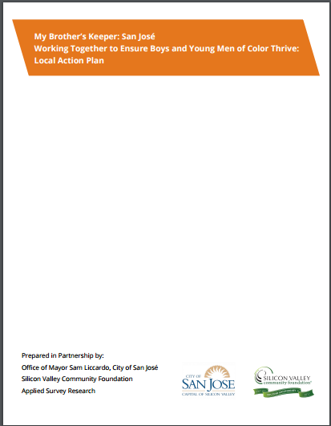
What did we Learn
In San José, African-American, Southeast Asian and Latino boys are least likely to successfully reach key milestones:
San José MBK Local Action Plan - September, 2016
Entering kindergarten ready to learn
Reading at grade level by 3rd grade
Graduating from high school ready for college & career
Experiencing reduced youth violence with access to second chances

Slide 5
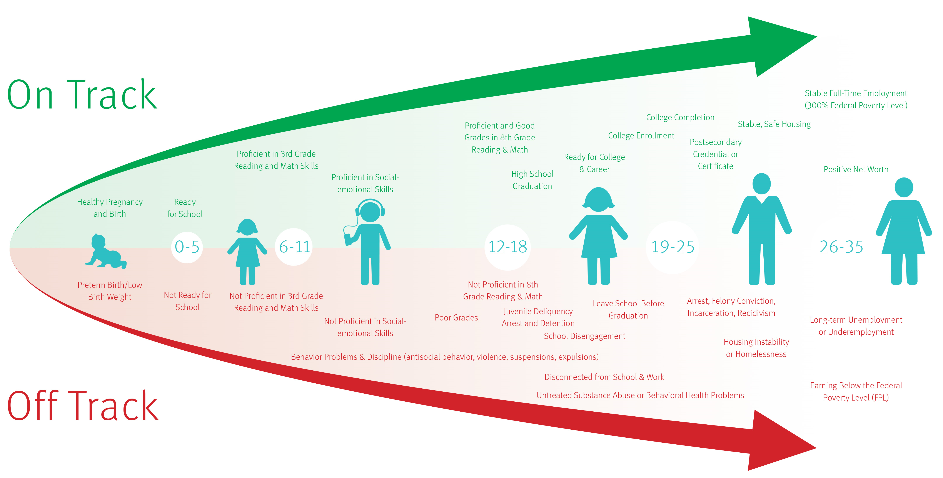
Life Course Framework*: Guidance on the need for a cradle to career approach
*Arnold Chandler presented his Life Course Framework for Improving the lives of boys and young men of color at the May, 2015 MBK: SJ community convening

Slide 6
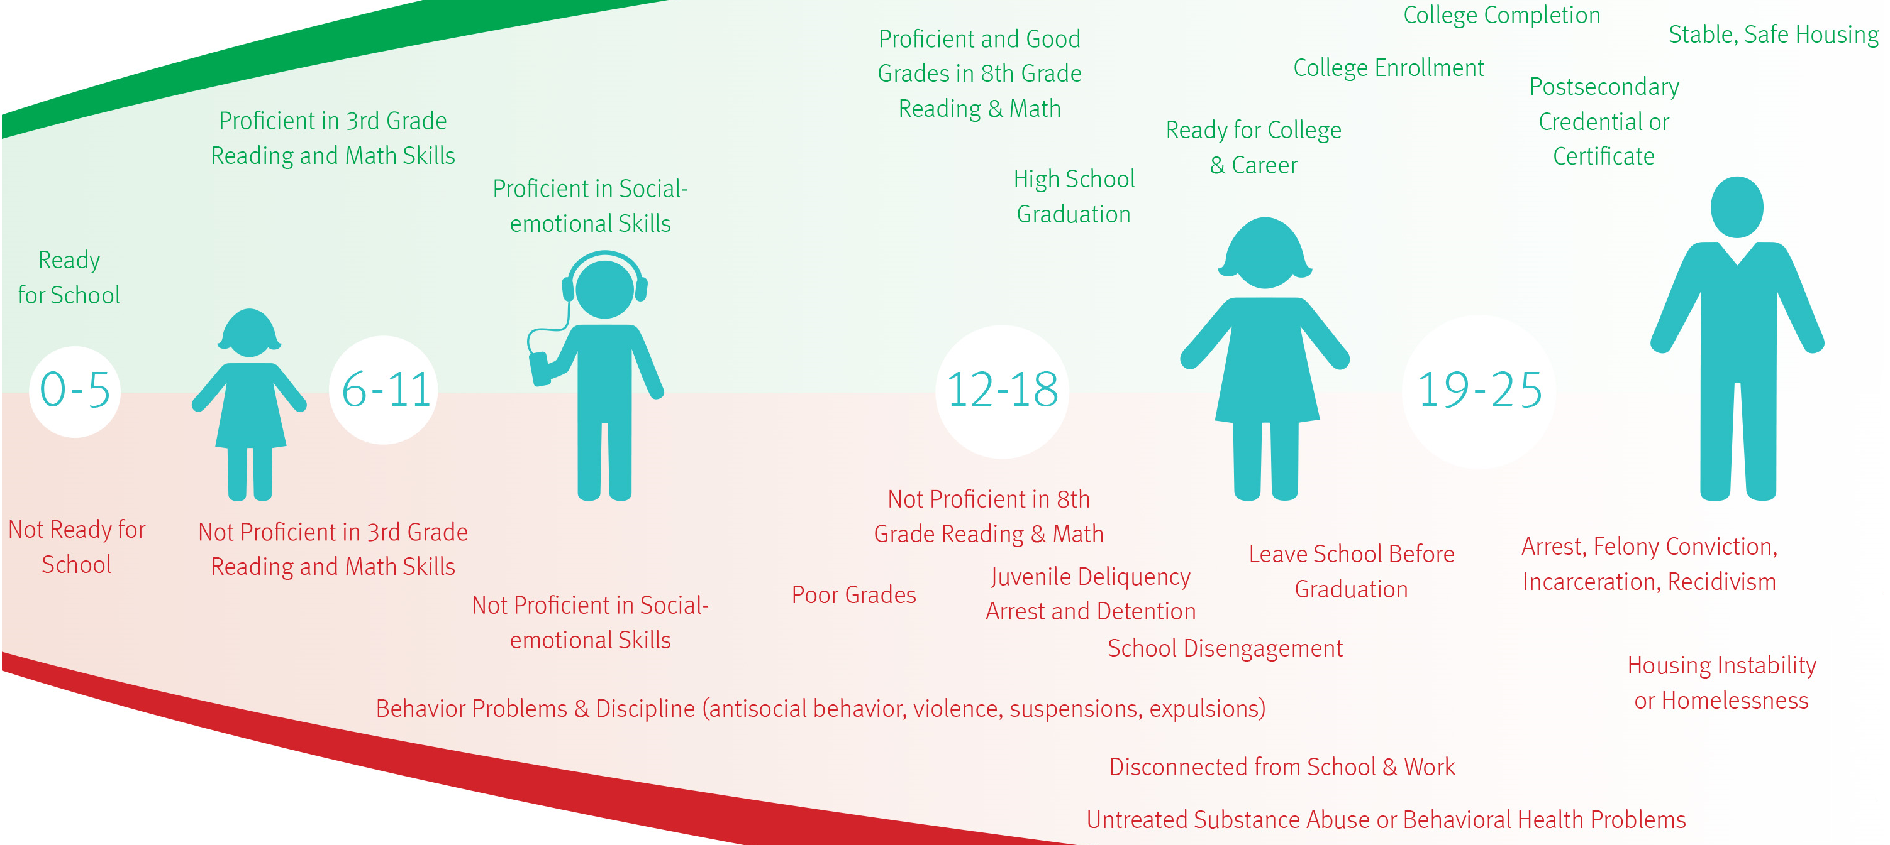


Foundation for San José’s Cradle to Career and Digital Literacy Strategy:

Slide 7
The MBK: SJ Strategic Plan
Develop a cradle to career education and digital literacy strategy that leverages existing City programs and resources and leverages community leadership and partnerships
Utilize data and evidence-based practice in program design and implementation
Embed the MBK: SJ Values into program design
Ensure accountability through reporting and evaluation

Slide 8
1. Citywide Education and Digital Literacy Strategy
MBK: SJ Milestone | Cradle to Career Strategy | Partners | Education & Digital Literacy Strategy | Baseline 2016-17 | Goal 2017-18 | Goal 2019-20
Entering Kinder Ready to Learn | Preschool to Third Grade | SCC Office of Education Smart Start Coalition | Quality Preschool | 495 | 800 | 1,000
 |  |  | Quality Early Learning Programs | 6,000 | 7,000 | 10,000
Reading & Math at Grade Level
 |  | Afterschool providers & school districts | SJ Learns & Quality K – 8 Afterschool & Summer Programs | 3,500 | 5,000 | 7,500
 | Elementary & Middle School
 |  | Tech company & tech training organization volunteers | Coding 5K Challenge Initiative | 2,000 | 3,000 | 5,000
Graduating from High School Ready for College and Career | High School & College | San José Evergreen Community College Dist. & West Valley CC | SJ Promise HS College Readiness Program | New | 1,000 | 1,500
 |  | the SVO, East Side Union H.S. & San José Unified School Districts | SJ Works Youth Employment Program | 1,000 | 875 | 1,400
 |  | SCC Office of Education Opportunity Youth Academy & Career Online High School | SJPL High School Diploma Recovery Programs | 250 | 625 | 750
 |  | San José Evergreen Community College Dist. & West Valley CC | SJ Promise – College Scholarship & Success Program | New | 800 | 1,500
Experiencing Reduced Violence & Access to Second Chances |  | SCC District Attorney, SCC Office of Education, School Districts | SJPD & all Districts: Single MOU guiding Police Officers on school campuses
 |  |  | SCC DA Truancy Reform & Amnesty Program | 18,000 | 3,000 | 3,000

Slide 9
Education & Digital Literacy Program Details
MBK Milestone | Dept Lead | City Program
Preschool to 3rd Grade | SJPL SJPL SJPL PRNS/SJPL SJPL / MO | Wee Play San José Children’s Areas Story time 1,000 Books Before Kindergarten Quality Preschool SJ Learns PK – 3rd Grade Extended Learning Programs
Elementary & Middle School | SJPL PRNS/SJPL SJPL SJPL SJPL | Summer Reading Challenge & online summer school partnerships Quality Afterschool Programs Homework Centers Online Tutoring Coding 5K Challenge
Graduating from High School Ready for College & Career | SJPL / MO SJPL / MO SJPL SJPL / MO | SJ Promise College Readiness – dual enrollment & counseling W2f SJ Works jobs & internships for at risk youth High School Diploma Recovery for youth & adults SJ Promise 2 year free community college: low income SJ HS grads
Experiencing Reduced Violence & Access to 2nd Chances | SJPD | School Liaison Unit – School Liaison Officers & Truancy Abatement

Slide 10
2. Utilize data & evidence-based practice
Design for outcomes, scale, and sustainability;
Leverage school and community resources and inter-departmental skills; and
Incorporate quality frameworks and assessments.

Slide 11
3. Embed MBK: SJ Values into Program Design
Identify and address instances of structural and racial bias;
Elevate restorative justice over punitive strategies;
Be inclusive of undocumented youth;
Apply outreach strategies that target populations;
Leverage technology to improve outcomes; and
Ensure cultural competency and community and family engagement.

Slide 12
4. Accountability & Outcomes
Baseline and set goals by:
capacity, enrollment and educational outcomes.
targeted populations and locations.
Report outputs and outcomes by
gender and ethnicity.
targeted populations and locations
Enter into data-sharing agreements to:
identify populations and locations in need
measure impact on student outcomes.

Slide 13
Next Steps
Thursday, October 5, 3:00 – 4:00 MBK: SJ Action Committee Conference Call (substitutes in-person meeting) for feedback on the MBK: SJ Strategic Plan.
Wednesday, October 11, 7:30-8:30 am: School City Collaborative (SCC) first quarterly meeting of the school year. The SCC will continue to provide guidance to the City’s educational priorities and work in partnership in design and implementation.
Wednesday November 1, 2017: 10:00 – 12:30 CA Assembly Select Committee on the Status of Boys and Men of Color Informational Briefing at the Rotunda at San José City Hall. 12:30 – 2:00 Lunch for Assembly Members, City Council Members, Donors and MBK: Action Committee Members
Thursday, December 14, Presentation of the Citywide Education and Digital Literacy Strategy to the San José City Council Neighborhood Services and Education Committee. The meeting is open to the public, begins at 1:30 and is located in the City Council Wing Room

Slide 14
…But what will it really take
Keep an eye on the prize:
Close the 3.5K preschool seat gap for low-income 3 & 4 year-olds
Address the 4K afterschool seat gap for at-risk K – 3rd graders
Expand the work to improve high school graduation, and college readiness and success rates so that every San Jose 9th grader has at least a 50% probability of experiencing college success

Slide 15
And
Work collaboratively across City departments and with local and state partners and government to
Align data needs, resources and people-power
because
When San Jose’s boys and young men of color succeed, all children succeed.

